Slide 1
Assignment Answer
Activity Duration Estimating

Slide 2
Program Evaluation and Review Technique (PERT)
PERT is a network analysis technique used to estimate project duration when a high degree of uncertainty about individual activity duration estimates exists
PERT uses probabilistic time estimates based on
optimistic
most likely
pessimistic
estimates of activity durations

Slide 3
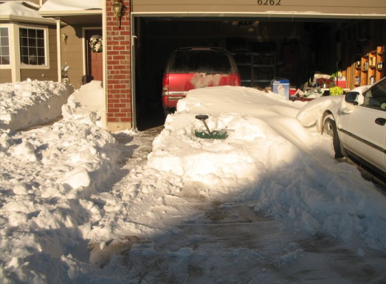
PERT (Program Evaluation and Review Technique)
Optimistic + 4 X most likely + pessimistic = Duration
6
Activity “Shovel the Snow off the Driveway”
Optimistic Estimate = 1 hour
Pessimistic Estimate = 6 hours
Most Likely Estimate = 2 hours

Slide 4
PERT Task Duration Calculation
PERT Weighted Avg =
Optimistic + 4*Most Likely + Pessimistic
6
Most Likely
(Use in CPM Calcs)
Beta Distribution
Optimistic
Pessimistic
Possible Durations

Slide 5
PERT Three Point Estimate – Part A
Activity | Optimistic | Most Likely | Pessimistic
A | 4 | 9 | 16
B | 3 | 6 | 9
C | 6 | 12 | 24
Part A: Calculate the PERT Expected Duration for each Activity

Slide 6
PERT Task Calculations – Part B
You can use PERT expected durations just like single point duration estimates
Once you have the expected duration estimates, you calculate the standard deviation and the variance:
Task Standard Deviation = (P-O)/6 (alternative formula)
Task Variance = (Standard Deviation )2
Part B: Calculate the Standard Deviation for each activity individually.

Slide 7
PERT – Project Std. Dev. – Part C
Activity | Optimistic | Most Likely | Pessimistic | PERT Duration | Standard Deviation | Variance
A | 4 | 9 | 16 | 9.33
B | 3 | 6 | 9 | 6
C | 6 | 12 | 24 | 13
Total
 |  |  |  | SD for ABC
Part C: Calculate the total standard deviation for the project
Project (ABC) SD = the square root of the sum of the task variances.
To obtain the Standard Deviation for a series of activities (a network or a project), statistical rules do not allow you to simply calculate the variance for each activity and add them up. You must calculate each activity’s variance, add them together and then take the square root of that figure to get the standard deviation for a series of activities.
7

Slide 8
PERT Deadline Probability – Part D
Part D: What is the probability (expressed in terms of percentage) that you will get this project (ABC) done in approx. 32 Days?

Slide 9
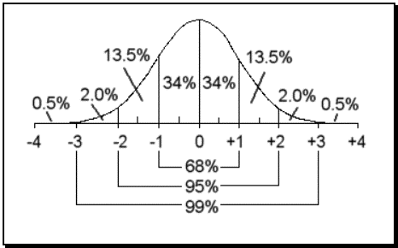
Normal Distribution*
MEAN
Probability of the value = the area under the curve
*Area under the Curve
Plus ONE Standard Deviation

Slide 10
Assignment Summary
Part A:
Calculate the PERT Expected Duration for each Activity
Part B:
Calculate the Standard Deviation for each activity individually.
Part C:
Calculate the total standard deviation for the project
Part D:
Determine % probability that the project (ABC) can be done in about 32 days.

